Slide 1

SOCIETY GATE PASS APP
ACADEMIC SESSION: 2018-22
Project Team:
Nancy
Neeraj Rana
Prerna Sikarwar
Prince Bhardwaj
Rahul Kumar
PROJECT GUIDE:
MR. Tejaswi Khanna

Slide 2
INTRODUCTION
Gate pass is a mobile system to manage visitors in and out from a premise. Its help to keeps track of all visitors. In this security and monitoring has will added .It eliminates need for manual register at the entry and exit .It keeps all the data on cloud. Only you can access your data. It reports to trace is visitors in and out of tremises.
In modern times where security becomes more challenging in buildings and commercial complexes, residential societies find it mandatory to track visitors. In this case, a guest management software such as Visitor is a perfect and smart solution to manage and track guests, daily workers, contract labours, servants of residential complexes, apartments, housing colonies or in other words society as a whole. During this pandemic, security becomes the main aspect for the societies.

Slide 3

Abstract
-> Society Gate Pass for School is an android application.
-> This application can be used to track being carried out of the gate by vendors, services, staff and visitors.
->It also enables maintaining a record of material moving out of your flat or your society.
-> This applications allows residents to monitor who is entering the society.
-> It ensures that the visitors are recorded and allowed in the the premises only after confirmation from the host.

Slide 4
OBJECTIVE/AIM
In many large organisations, a lot of movements take place every day. It may be employees moving in or out, movement of raw materials for production etc. All these movements of the organisation’s premises, factories and companies needs to be monitored and controlled. This is where the concept of a gate pass comes into play. Gate pass can be used to authorise the movements of humans, materials and machines to or from the premises of the organisation. It will help to monitor and track all the movements happening in an organisation.

Slide 5

NEEDS
-> To improve the managing the records of visitors in a society.
-> To reduce time wastage.
-> To reduce the calculation problems of the details of the visitors.
-> To reduce the paper wastage and save trees etc.

Slide 6
GOALS
-> This System helps the user to maintain the records of visitors in and out in a society in a very easy way.
-> The visitors need not have to write their details again and again when they in and out.
-> This system will help the society to know the history records of the visitors.
-> It gives reliable and efficient security protection on which one can rely.

Slide 7

Theoretical Background
-> Front End:
Java
XML
-> Tools Used:
Android Studio(kitkat)
Firebase
-> Back End:
PHP
SQL

Slide 8

Flowchart
User
Society Gate
Pass App
Report
Database

Slide 9
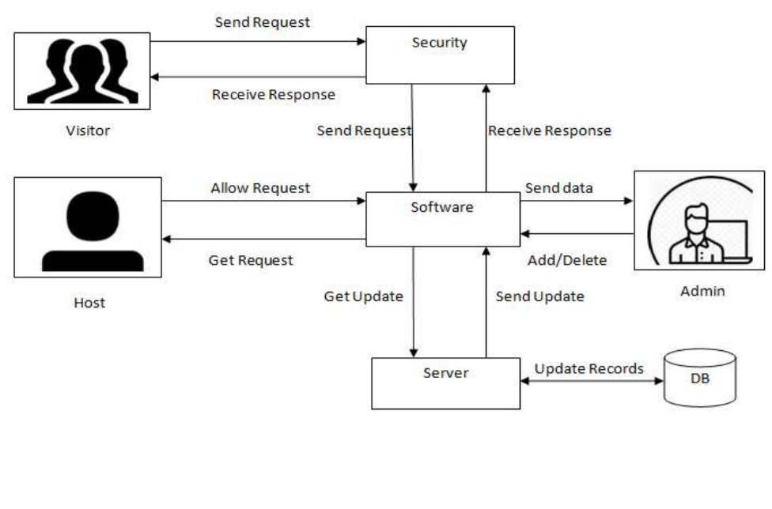
Block Diagram

Slide 10
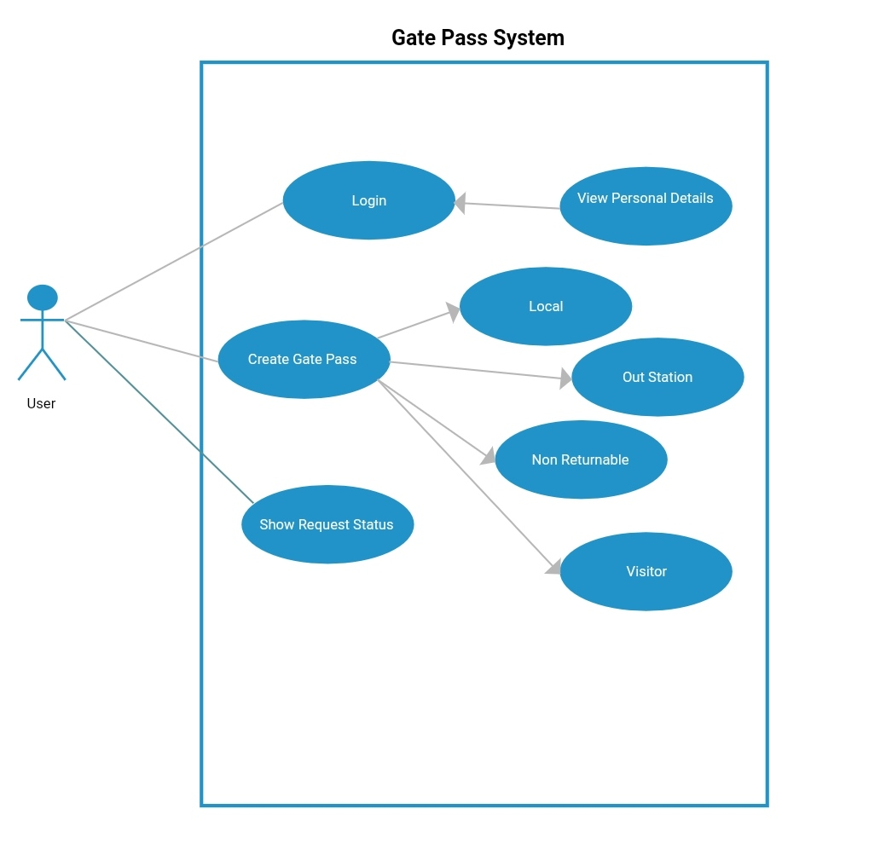
Use Case Diagram

Slide 11
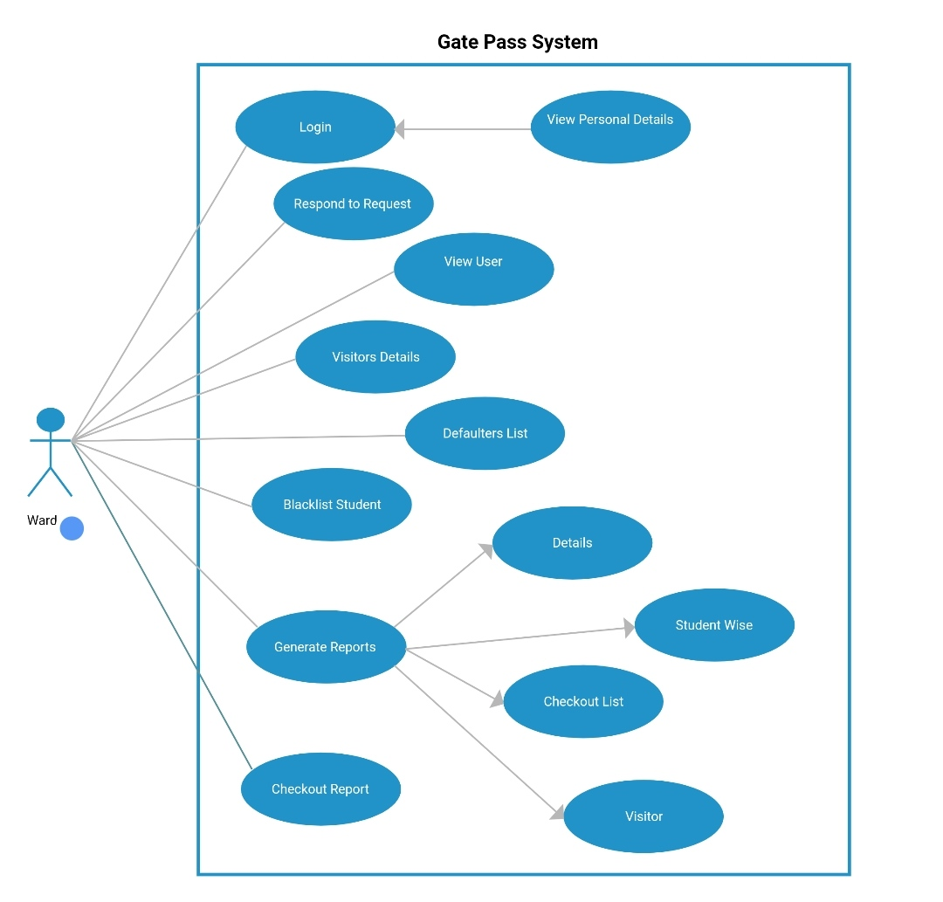
Continue…

Slide 12
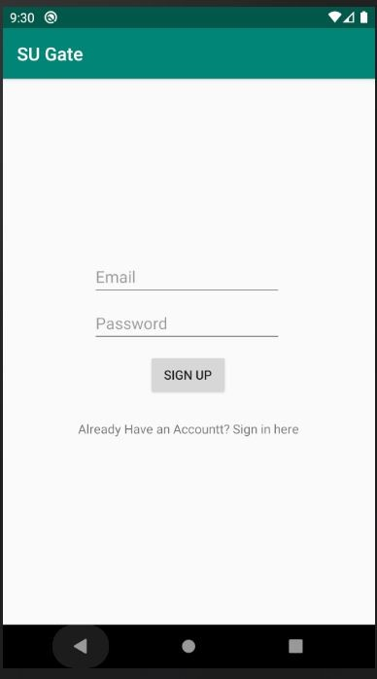
Application Layout

Slide 13

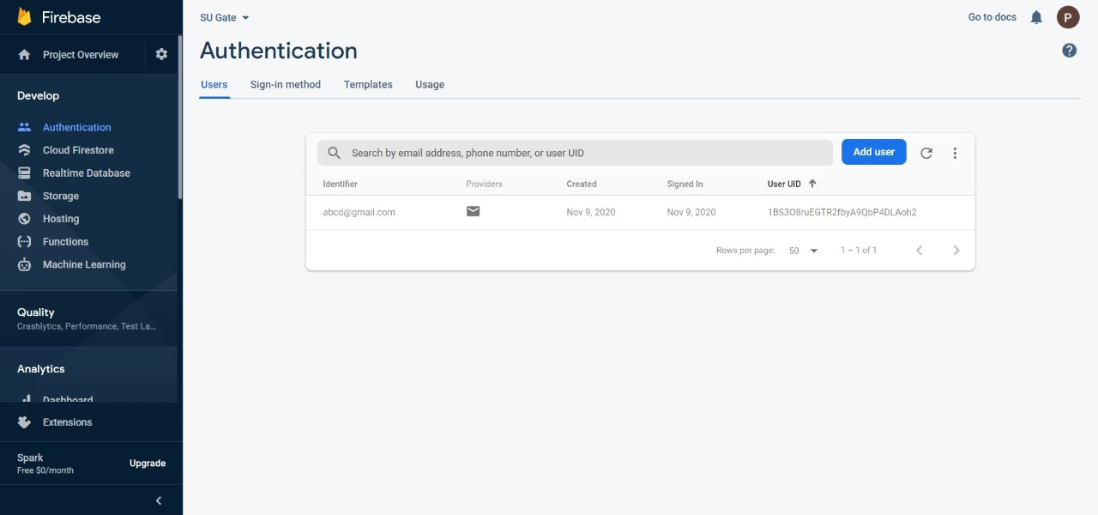
Database Layout

Slide 14
Advantages and Limits
-> Reduces time wastage.
-> Give perfectness in work.
-> Give stress free environment regard attendance.
-> Reduces paper wastage etc.

Slide 15
Conclusion
It provides a way to effectively control, & track your organization's visitor traffic. It helps to prevent the entry of any unauthorized or unwanted person in the premises. The flexible architecture of Visitor gate pass management System allows various people in the organization to directly access the data they need. This system enhances the security and productivity of the premises.

Slide 16

Thanks!!

